Slide 1
Best Practice Standards for representing First Nations clients & how to put these into practice
Artwork: © Luke Penrith
Lauren Davies, Senior Solicitor, Legal Aid NSW
Emma Hudson-Buhagiar, Senior Solicitor, Aboriginal Legal Service
Notes:
Need to find a ALS Graphic

Slide 2
Overview
Lawyers should be accountable; culturally safe; Trauma-informed; and responsive to the needs of Aboriginal and Torres Strait Islander clients.
Ongoing learning and understanding of how to provide culturally safe and trauma informed representation is critical.
Aboriginal Field Officers (AFOs) and other Allied Professional Staff are critical to Lawyers achieving Best Practice Advocacy.

Slide 3
Overarching Considerations
Understanding culture and community
Kinship
Men’s Business and Women’s Business
Sorry Business
Trauma, Emotional and Social Wellbeing
Mistrust of governments
Trauma informed practice

Slide 4
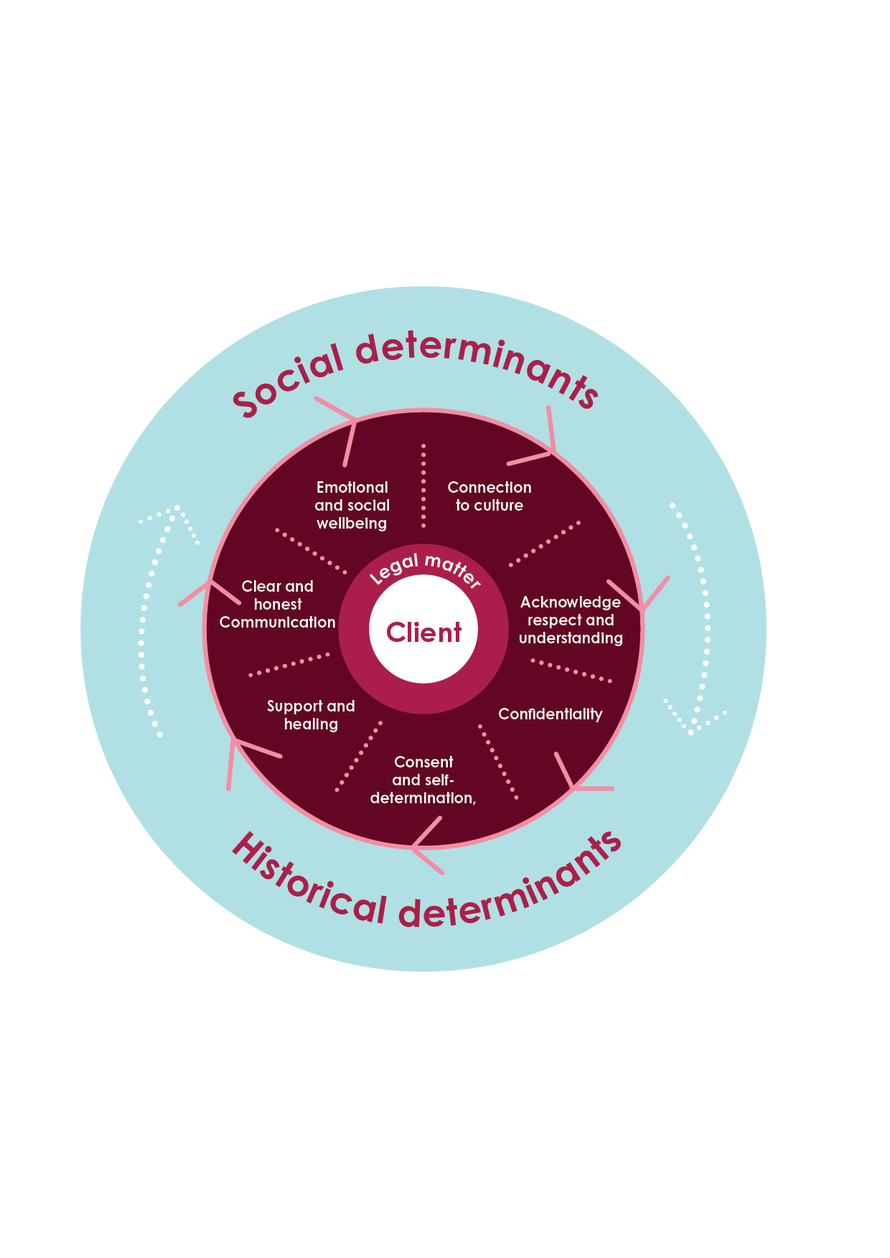
The Interplay of Social and Historical Determinants, Best Practice Standards and Client Focus Legal Advocacy
Image adapted from Gee et al (2014)
Notes:
Image adapted from ‘Social and Emotional Wellbeing Framework depicting the interplay of social and historical Determinants’ from Gee et al (2014), cited in Pat Dudgeon et al, Aboriginal Participatory Action Research: An Indigenous Research Methodology Strengthening Decolonisation and Social and Emotional Wellbeing (Lowitja Institute,2020), page 4.

Slide 5
Best Practice Standards
Clear and Honest Communication
Plain English
Consistent communication
Gratuitous concurrence
Periods of Silence
Eye contact
Clear expectations – don’t make promises you can’t keep

Slide 6
Best Practice Standards (continued)
Acknowledgement, Respect and Understanding
Acknowledge the clients' circumstances and lived experiences
Maintain continuity of files
Build rapport, be personable
Confidentiality
Reinforce confidentiality, don’t assume
Concept of shame

Slide 7
Best Practice Standards (continued)
Consent and Self-determination
Empower the client to make informed decisions
Ensure the client has the tools to make informed decisions
Confirm the clients understanding
Engage with an AFO or Aboriginal Controlled Organisation (ACCOs)
With consent, engage with the client’s support system, including kinship structures
Support and Healing
Help the client understand the legal system and the processes
Identify intersection and compounding legal and non-legal matters
Breakdown silos and develop cross-practice service delivery

Slide 8
Benefits of working with Aboriginal Field Officers
Clear and Honest Communication
Increases access to legal services for Aboriginal people and communities​
Helps maintain contact with clients
Ensures the client understands what is happening and is supported
Acknowledgement, Respect and Understanding
Provides culturally appropriate services to Aboriginal people and communities​
Assists with providing Community Legal Education to clients and communities

Slide 9
Benefits of working with Aboriginal Field Officers
Support and Healing
Identifies systemic issues (both legal and non-legal)​
Assists Lawyers to engage with ACCOs to provide holistic culturally appropriate support
Consent and Self-determination
Helps ensure the client is actively engaged in their legal matter
Helps empower the client to make informed decisions or ask questions

Slide 10
Applying Best Practice Standards: Duty List
Local Court and Childrens Court.
“What's the persons story?’” rather than “What's wrong with that person?”
Minimising re-traumatisation.
Active listening.
Dos and Don’ts and examples

Slide 11
Applying Best Practice Standards: Walama List
Walama List
Prioritising the client's voice and how?
Preparation and planning
Strengths based approach
Affidavits

Slide 12
Utilising services in ALS and Legal Aid
Aboriginal Legal Service
Aboriginal Field Officers
Mental Health Advocacy and Referral Service (MHARS).
Women's Bail Advocacy Program
Legal Aid NSW
Aboriginal Field Officers
Financial Counsellors
Case workers
Social Workers

Slide 13
Questions?
© The Legal Aid Commission of NSW 2020

