Slide 1
Private Practitioners Forum
3 June 2021

Slide 2
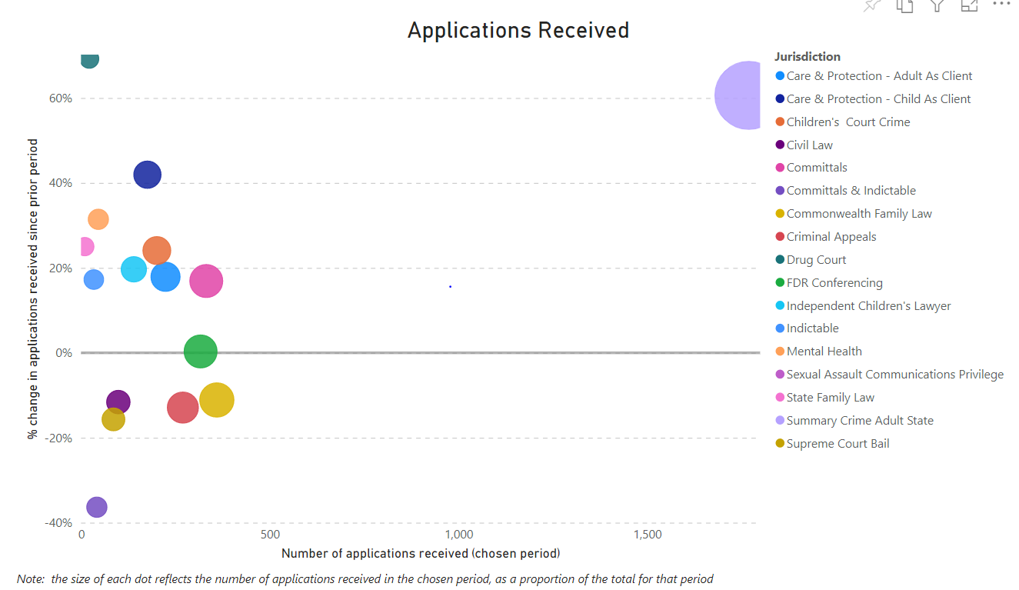
Applications Received April 2021

Slide 3
Strategies to Improve Processing Times
Automation
Consultant
Centrelink
Automation
Staff Access
Targeted Training
Inhouse
External

Slide 4
What can I do?
Best Contact Advice
Submit EVERYTHING through Grants Online
Respond to requisitions through the notification
Reduce multiple contacts

Slide 5
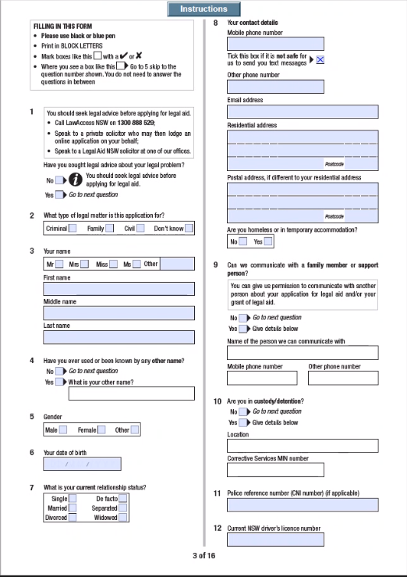
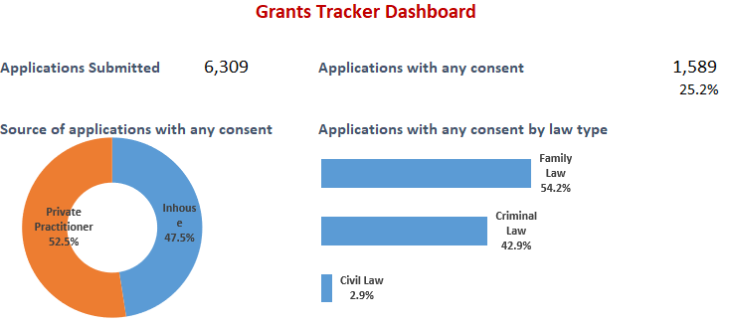
What can I do?
Apply Grants Tracker

Slide 6
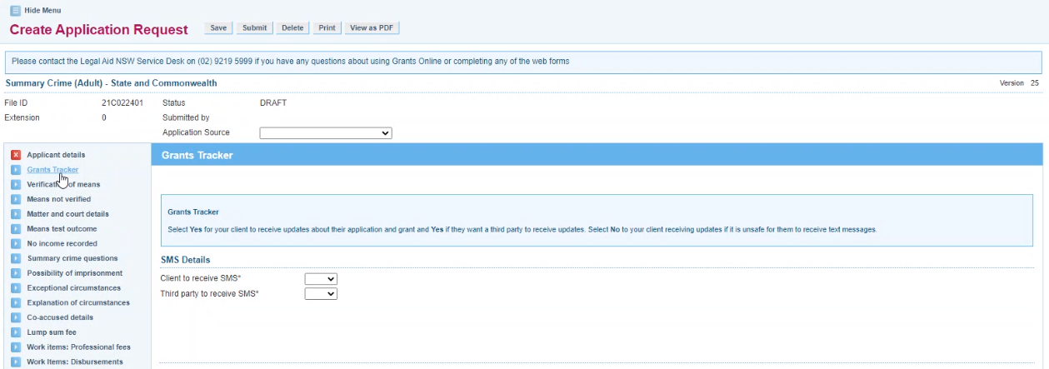
What Can I Do? Grants Tracker

Slide 7
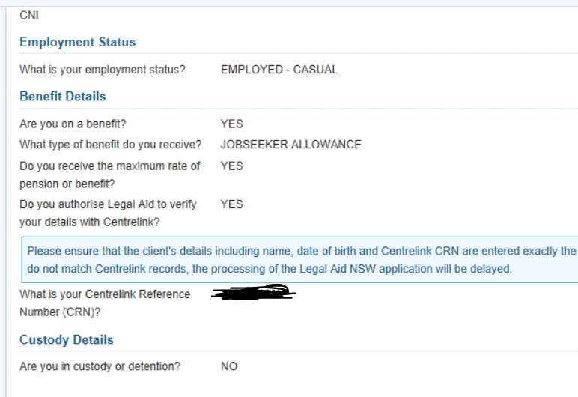
What can I do?
Correct Centrelink Details

Slide 8
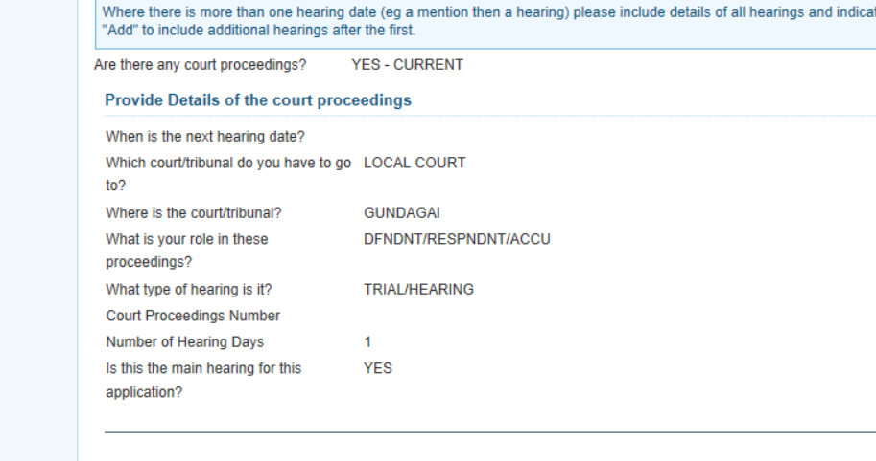
What can I do?
Enter Court Dates

Slide 9
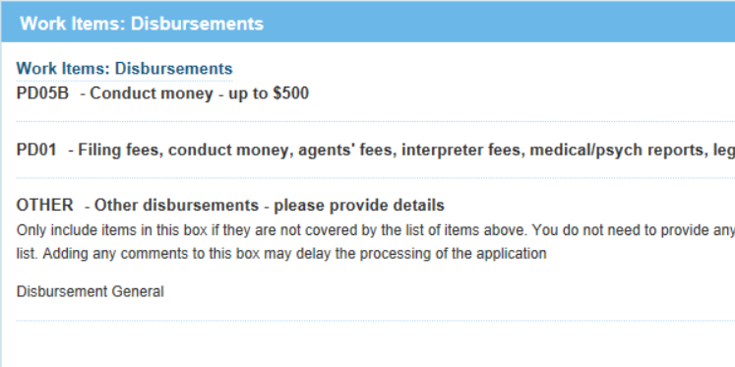
What can I do?
Reduce text in Free Text boxes
No need to write in free text box
if only seeking a lumpsum grant
Item included in scope
Eg Hair Follicle Testing

Slide 10
Take Aways
Submit everything through Grants Online
Appropriate contact for circumstances
Include ATLAS file number wherever possible
Use the Grants Tracker
Minimise free text

